Slide 1
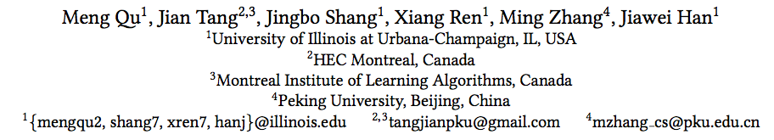
An Attention-based Collaboration Framework for Multi-View Network Representation Learning

Slide 2
Introduction
multiple types of proximities between nodes
Insufficient collaboration of views
Lack of weight learning

Slide 3
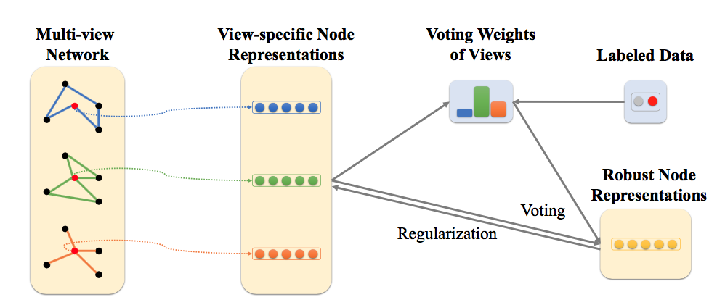

Multi view network embedding
the overall objective of the approach :

Slide 4




Collaboration Framework
Goal:
capture the node proximities encoded in individual views
meanwhile integrate them to vote for the robust node representations
for each view k, try to minimize the KL-divergence between the estimated neighbor distribution and the empirical neighbor distribution

Slide 5




Collaboration Framework
negative sampling
regularization term

Slide 6


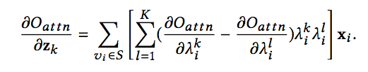

Learning the Weights of Views through Attention
the weight of view k for node v_{i}
Node classification:
Notes:
Xci是节点vi在所有view上的representation的concatenation. Zk是view k的特征向量

Slide 7

Learning the Weights of Views through Attention
Link prediction:

Slide 8
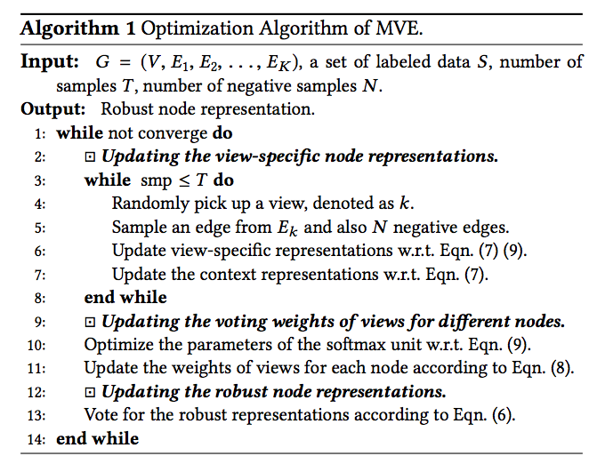
Model Optimization

Slide 9
